Slide 2
Durable Functions 2.0 - Serverless and Stateful Functions
Nivedha Lakshmanan
Software Engineer

Slide 3
Agenda
Serverless Architecture
Azure Functions Overview
Durable Functions
Patterns
Function Types
Durable Functions 2.0

Slide 4
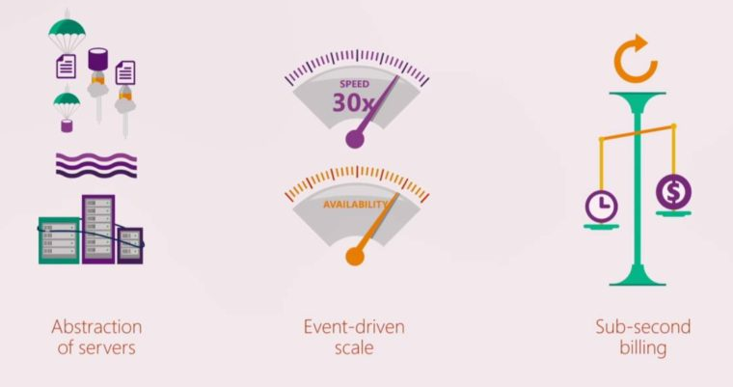
Serverless

Slide 5
Azure Functions
To run small snippet of code or functions in the cloud
Triggers and Bindings
No need to worry about infrastructure
Pay only for the time your code runs
Scalable

Slide 6
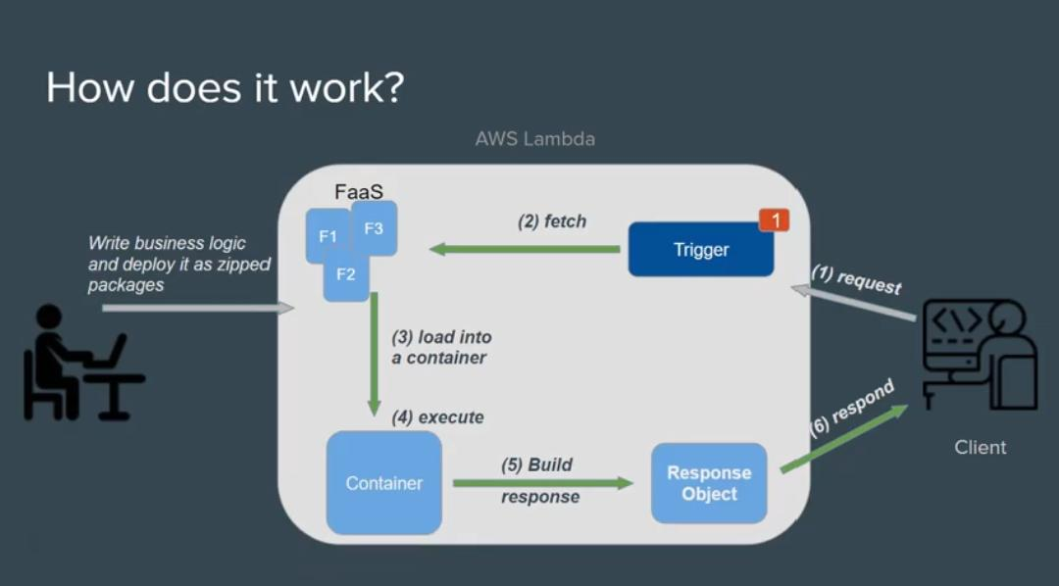
Why Serverless cannot maintain state ?
Information retained by the program is called State

Slide 7
Durable Functions
Durable Functions is an extension of Azure Functions
To write long-running orchestrations as a single function while maintaining local state

Slide 8
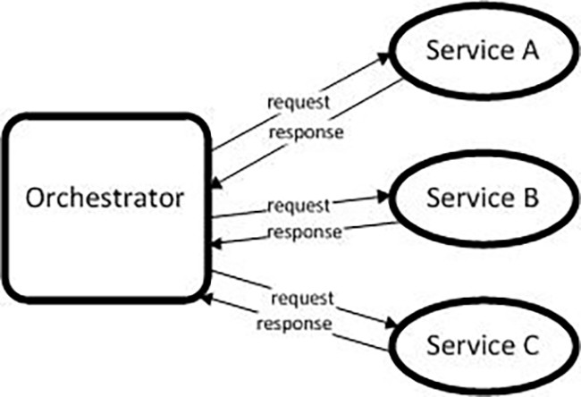
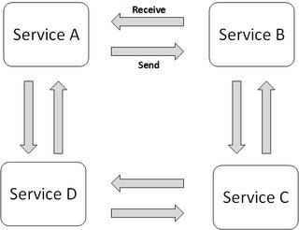
Why Durable Functions
Maintains state
Supports orchestration over choreography
Manages long running task

Slide 9
Durable Functions looks like
Orchestrator Function
// calls functions in sequence
public static async Task<object> Run(DurableOrchestrationContext ctx)
{
try
{
var x = await ctx.CallActivityAsync("F1“,null);
var y = await ctx.CallActivityAsync("F2", x);
return await ctx.CallActivityAsync("F3", y);
}
catch (Exception)
{
// global error handling/compensation goes here
}
}
Activity Functions
Notes:
> So in Durable Functions, we introduce the concept of “an orchestrator" that will orchestrate or manage what happens between rest of the Functions.
> It is responsible for calling and receiving output from activity functions that you’re familiar with as regular functions. When an activity returns, it return value becomes part of the local state of the orchestrator function so you’re able to work with it as any other variable in that block of code.
> CallFunctionAsync uses queues under the covers, thus they can be scaled out to multiple VMs.
The other thing is that if I want to have exceptions in my code, say something goes wrong in a particular function, I can do that. We’re all familiar with the syntax and now we can do it in a distributed way.
Mention rewind feature to talk about in new developments

Slide 10


var outputs = new List<string>();
outputs.Add(await context.CallActivityAsync<string>("SayHello", “World"));
return outputs;
History Table
Orchestrator Function
Orchestrator Function
Activity Function
Orchestrator Started
Activity Function
Execution Started
Task Scheduled, SayHello, “World”
Orchestrator Completed
“Hello World!”
“Hello World!”
Task Completed, “Hello World!”
[“Hello World!”]
?
Orchestrator Started
Execution Completed, ["Hello World!”]
Orchestrator Completed
Execution History
Notes:
Grasping how orchestrators use execution history to replay and rebuild their local state is key to understanding how Durable Functions works, so let’s walk through the execution of a simple orchestrator function.
The light blue box at the top of the slide is the orchestrator’s code.
“SayHello” our activity function, which returns “Hello” and whatever input you give it.
Our execution history is currently empty. As we start to record events, they’ll show up here. (Indicate area.)
1. A request is made to the orchestrator function.
2. The orchestrator starts and begins executing until it’s asked to await some async work. In this case, we want to call an activity function.
3. The orchestrator checks the execution history for a record of the activity function.
4. There’s no record of the activity function being called or completed, so the orchestrator schedules that work.
5. While the orchestrator waits on work to complete, it shuts down.
5. The scheduled activity function runs.
6. A record of this is added to the execution history. In this case we produced output, so that’s stored.
7. Now the orchestrator has more work to do. It restarts and executes its code **from the beginning** to build up its local state.
8. As before, the orchestrator executes until it reaches an await.
9. The orchestrator checks the execution history. This time there’s a record of the async work being done.
10. The activity function’s stored output is passed back to the orchestrator. In this case, the value is added to a list of strings.
11. The orchestrator continues executing. In a more complex orchestrator with multiple await calls, the checkpoint, schedule and replay steps would repeat for each one. This orchestrator runs to completion and returns its output.
12. And we’re done!
- How does the framework know to wake up

Slide 11
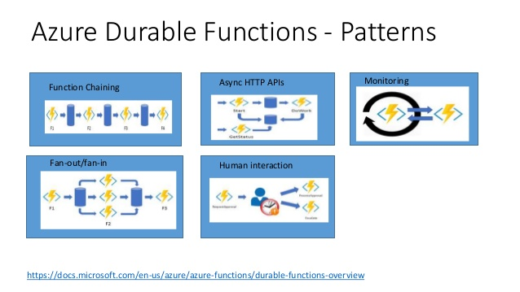
Patterns

Slide 12
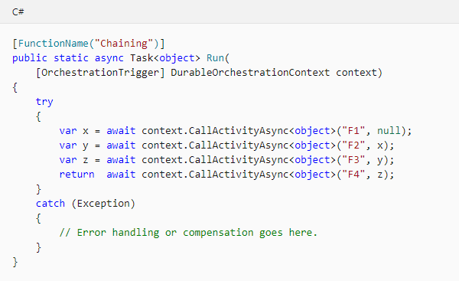
Function Chaining
The output of one function is applied to the input of another function in a sequential manner

Slide 13
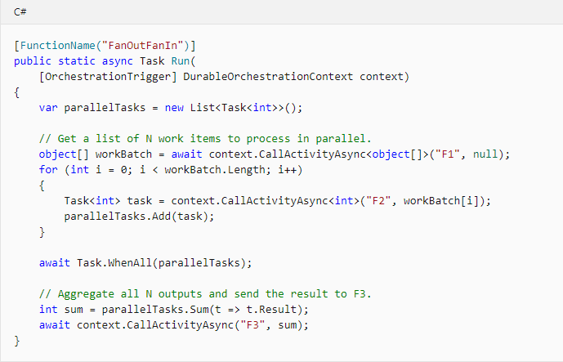
Fan-out/Fan-in
Multiple functions run in parallel and then wait for all functions to finish. Often, some aggregation work is done on the results

Slide 14
Async HTTP Trigger
This pattern is implemented by having an HTTP endpoint trigger
As it is long-running action, it redirects the client to a status endpoint where the client polls to learn when the operation is finished

Slide 15
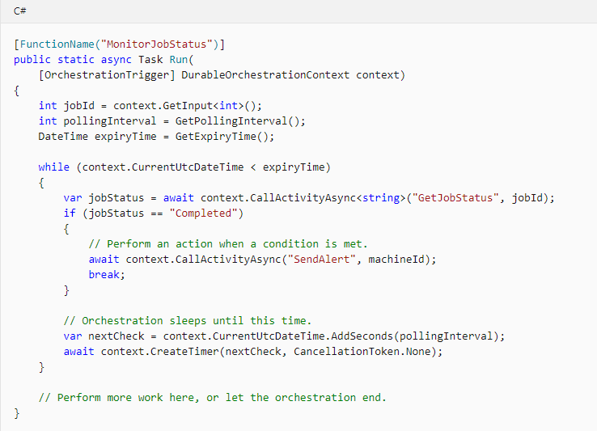
Monitoring
It refers to a flexible, recurring process in a workflow
An example is polling until specific conditions are met

Slide 16
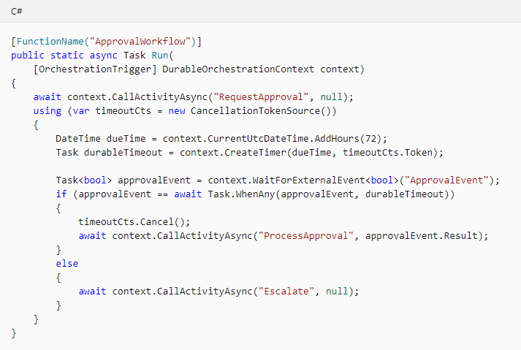
Human Interaction
Many automated processes involve some kind of human interaction. It allows interaction by using timeouts and compensation logic

Slide 17
Aggregator
The data being aggregated may come from multiple sources
It may be delivered in batches, or may be scattered over long-periods of time.
The aggregator might need to take action on event data as it arrives, and external clients may need to query the aggregated data.

Slide 18
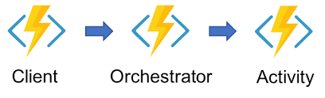
Function Types
Client function – The primary way to deliver these messages is by using an orchestrator client binding or an entity client binding from within a client function.
Orchestrator Function – Describe how actions are executed and the order in which it executes
Activity function – The tasks that are orchestrated in the process

Slide 19
Entity Functions
Define operations for reading and updating small pieces of state
Follows circuit-breaker pattern

Slide 20


Circuit Breaker Pattern

Slide 21

Circuit Breaker Pattern

Slide 22
Circuit Breaker Pattern

Slide 23

Circuit Breaker Pattern

Slide 24
Circuit Breaker Pattern
Durable Entity

Slide 25

Circuit Breaker Pattern
Durable Entity

Slide 26
Durable Entities

Slide 27
Quick Demo

Slide 28
References
https://docs.microsoft.com/en-us/azure/azure-functions/durable/durable-functions-overview
https://docs.microsoft.com/en-us/azure/azure-functions/durable/durable-functions-preview

Slide 29
Thank You

